Slide 1
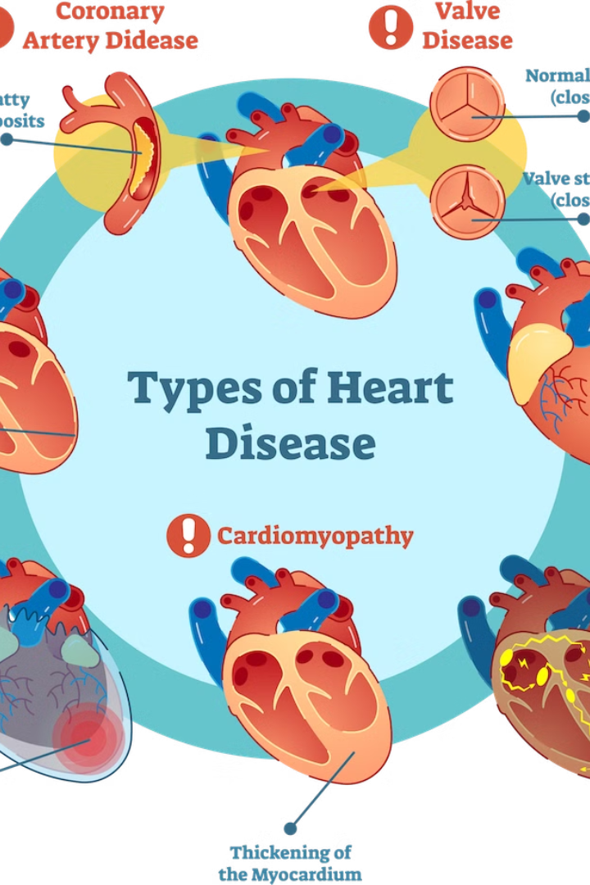
Heart Disease Diagnostic Analysis
This presentation will provide a comprehensive analysis of heart disease diagnosis, exploring the dataset structure, model architecture, and key findings from exploratory data analysis.
by Jayent Singh Parihar

Slide 2

Introduction
1
Understanding Heart Disease
2
Predictive Modeling
Heart disease is a leading cause of mortality worldwide, making accurate diagnosis crucial for effective treatment and prevention.
Machine learning techniques can be leveraged to develop predictive models for early detection of heart disease.
3
Insights for Clinicians
This analysis aims to uncover valuable insights that can aid clinicians in heart disease diagnosis and management.

Slide 3
Problem Statement
Objective
Significance
Challenges
To develop a robust machine learning model that can accurately predict the presence of heart disease based on patient data.
Early and accurate diagnosis of heart disease can lead to timely interventions and improved patient outcomes.
Identifying the most relevant features and addressing potential biases in the dataset to build a reliable predictive model.

Slide 4
Approach
Data Collection
1
Gather relevant patient data from medical records and databases.
2
Data Preprocessing
Clean, transform, and feature engineer the dataset to prepare it for modeling.
Model Development
3
Train and optimize various machine learning algorithms to find the best-performing model.

Slide 5
Structure of Dataset
Features
Target Variable
The dataset includes patient information such as age, gender, blood pressure, cholesterol levels, and more.
The target variable is a binary classification of whether the patient has heart disease or not.
Data Size
Data Quality
The dataset comprises records for over 300 patients, providing a sufficient sample size for analysis.
The dataset has been carefully curated, with minimal missing values and outliers.

Slide 6




Architecture
Data Preprocessing
Cleaning, imputing missing values, and encoding categorical features.
Feature Engineering
Creating new features from the existing data to improve model performance.
Model Training
Applying various machine learning algorithms and tuning hyperparameters.
Model Evaluation
Assessing the model's accuracy, precision, recall, and F1-score on a held-out test set.

Slide 7




Exploratory Data Analysis (EDA) Report
Age
Blood Pressure
Cholesterol
Gender
Older patients are at a higher risk of developing heart disease.
Elevated blood pressure is a significant risk factor for heart disease.
High levels of LDL cholesterol increase the risk of heart disease.
Males are generally at a higher risk of heart disease compared to females.

Slide 8
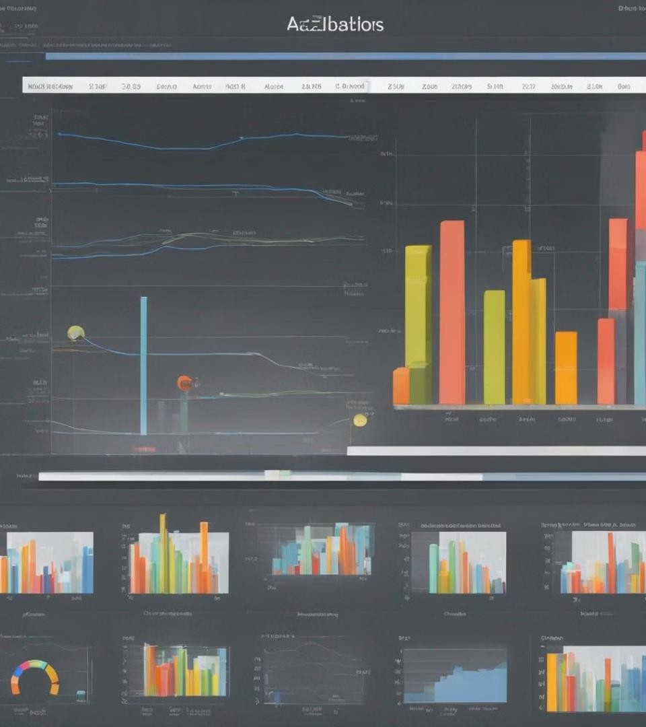
Visualization and Insights
This section will focus on visually representing key insights derived from the dataset. It will involve visualizing gender distribution and its relation to heart disease, as well as comparing chest pain types and their distribution among patients.

Slide 9
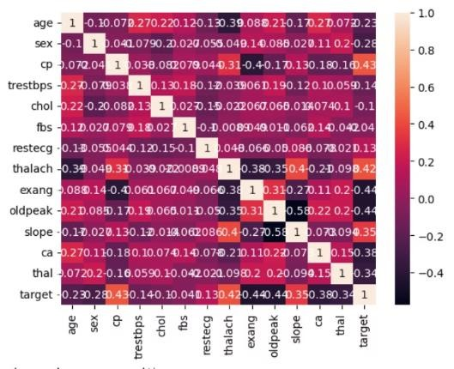
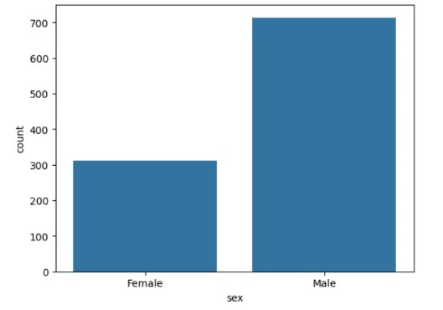
Co-relation matrix
Count of Male and Female
Positive Correlation : cp, thalach, slope with target
Male : 713
Negative Correlation :ca, oldpeak, exang, sex, age with target
Female : 312

Slide 10
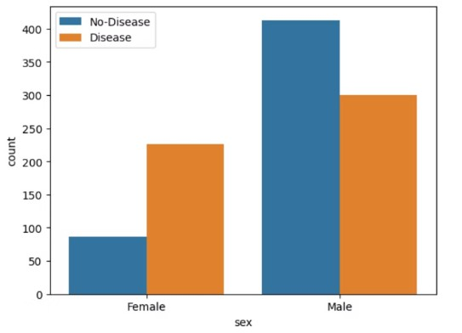
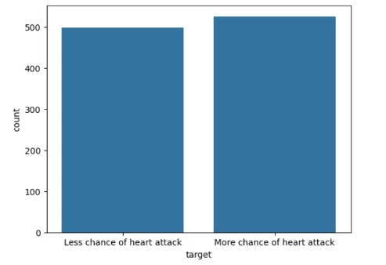
Gender Distribution According to the Target Variable
How Many & How Don't People have Heart Disease
More Disease and No-Disease patients are Men
People who have more chance of heart attack: 526
People who have less chance of heart attack: 499

Slide 11
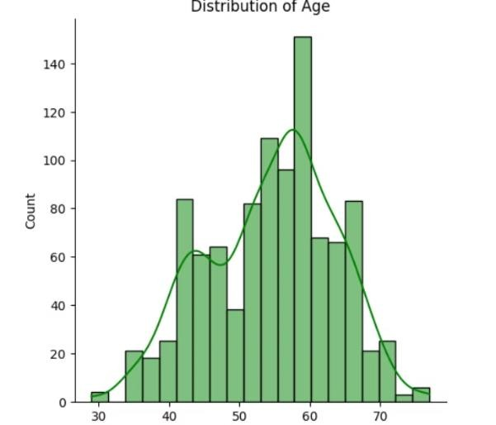
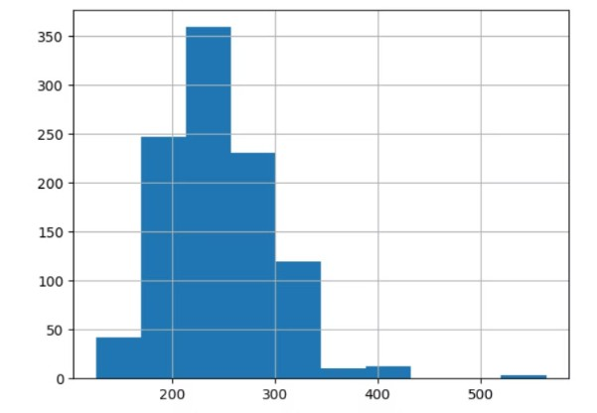
Distribution of Serum Cholesterol
Age Distribution in the Dataset
Most of the people in the study, have age in between 50-60
Healthy Cholesterol is <200 mg/dl

Slide 12
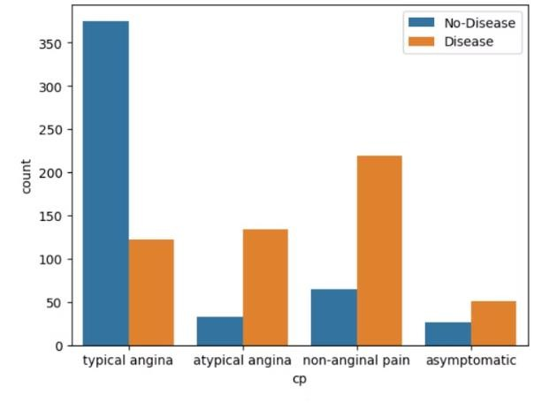
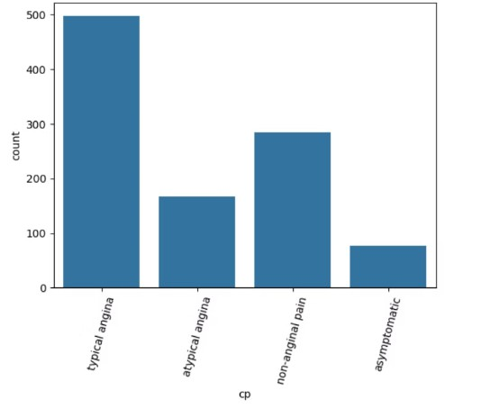
Chest Pain Distribution As Per Target Variable
Chest Pain Type
Healthy people having Chest Pain due to stress ,
physical activity etc , & varies as per gender
Chest pain type "Typical angina" is
common

Slide 13
Further Analysis :
Further analysis will delve into the investigation of resting blood pressure and its correlation with heart disease, along with the exploration of Fasting Blood Suga and their distribution.
Histograms showing the distribution of resting blood pressure to provide a visual
representation of the analysis.

Slide 14
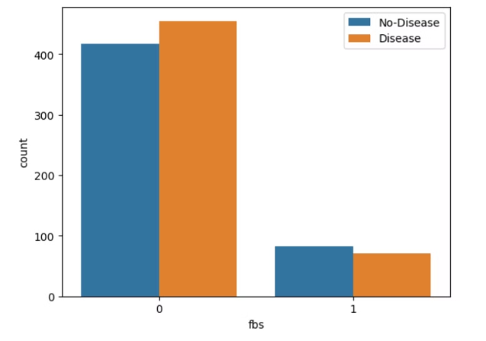
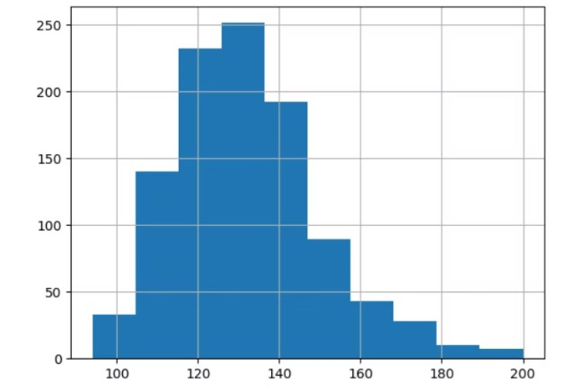
Fasting Blood Sugar Distribution According To Target Variable
Resting Blood Pressure Distribution
Fasting blood sugar > 120 mg/dl is Diabetes indicator without Disease.
It show that bp of people is between 120 and 130

Slide 15
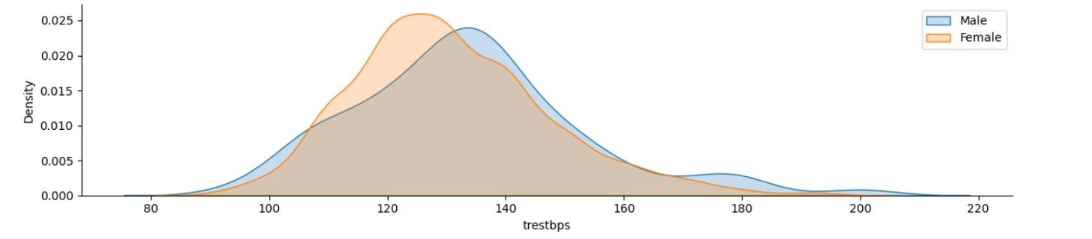
Resting Blood Pressure as per Gender
Females having less resting bp (120 ) than male (140)

Slide 16
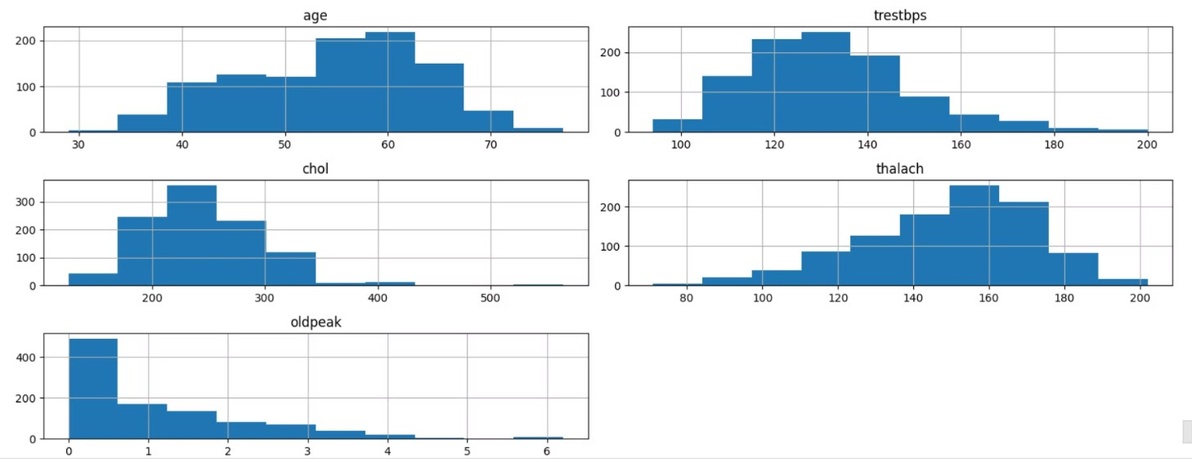
Plot Continuous Variable
Columns 'age', 'trestbps', chol', 'thalach', 'oldpeak' have Continues values

Slide 17
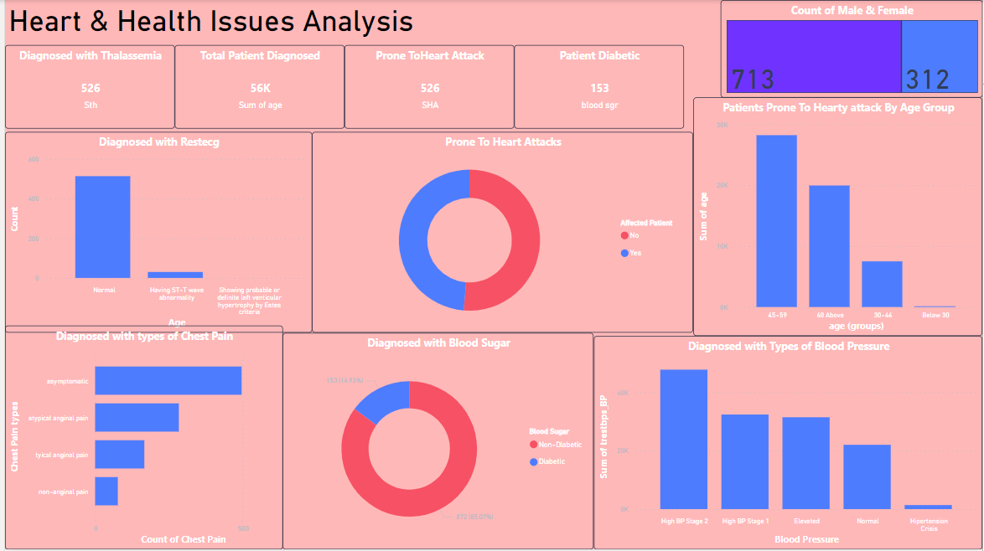
Dashboard

Slide 18
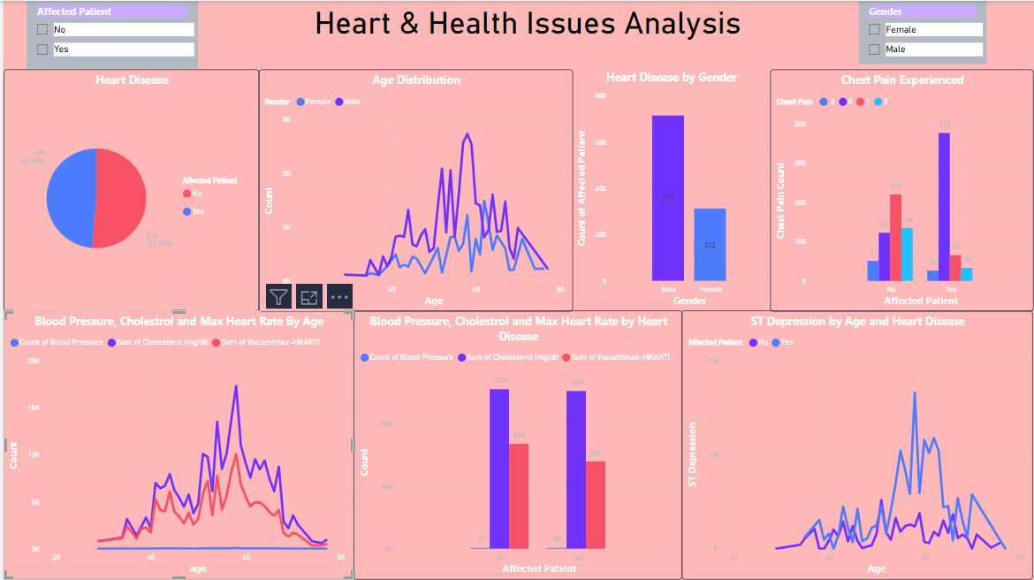
Dashboard

Slide 19

THANK YOU
This concludes the Heart Disease Diagnostic Analysis presentation. We hope the insights and recommendations provided will contribute to improved heart disease diagnosis and care.

